Slide 1
Polarion Workshop agenda
Date | Agenda | Expectations from participants | Expected outcome
Sep 21st | Review Polarion deliverables. Conduct brief demo of Polarion configuration. | Review and critique Polarion deliverables/ processes Approximate duration – 2-3 hrs | Understand the user’s pain areas. Upgrade/change the Polarion process or deliverables where possible.
Sep 22nd | Follow up with individual participants with specific follow-up questions. | Be available for the 1 on 1 meetings, share sample quality records. Approximate duration – 1 hr/ participant | Discuss alternate solutions and decide on optimal configuration. Upgrade/change the Polarion process or deliverables where possible.
Sep 23rd | Conduct detailed demo of the Polarion process and deliverables. Record open questions. | Review and critique the deliverables/ processes Approximate duration – 2-3 hrs | Upgraded Polarion configuration that is closer to user’s expectation. Draft plan to address open questions.
Polarion deliverables in scope for workshop-
Polarion Module | Deliverable
Requirements Management | Input source documents -VOC, VOB, HDA
Requirements Management | Customer Requirements Document
Requirements Management | System Requirement Document
Requirements Management | Subsystem Requirement Document (HRS and SRS)
Test Management | Verification protocols
Test Management | Verification reports
Requirements Management | Product Requirements Trace Matrix

Slide 2
Polarion Implementation Project
Test Management Module
Equipment and software only projects
September 2022

Slide 3
Outline
Fundamentals 5-10 min
Polarion data objects
High level process definition
Surgical Vision deliverables vs Polarion Data model 20-30 min
Surgical Vision deliverables → Polarion data model
Discussion on Polarion deliverables
User interaction with Polarion 30-40 min
Demo- “How to use Polarion to generate the JJSV deliverables?”
Validation
Approach for Vision configuration
Functional specification
User Acceptance Testing…

Slide 4
Fundamentals

Slide 5
What is work item? Why is it used?
Work Items represent various artifacts - for example requirements, tasks, change requests. Each artifact type is represented in Polarion by a Work Item type.
Each work item has multiple fields for user input, such as,
Author
Title
Description
Project
Approval status
Etc...
All the data referenced in the PRTM, FMEAs or Risk Assessments are stored in Work Items.

Slide 6
Document vs Report
 | Document | Report
Definition | Documents (or LiveDocs) are document-like containers for both free-form text and granular Work Items. (think MS Word) | Report Page (or LiveReport) are custom-built layouts for a report with charts that retrieve, aggregate, and/or format Work Item and other project data.
OOTB Redlining feature | Document has OOTB redlining feature. | LiveReports do not have OOTB redlining feature.
Traceability tables and data tables | Document do not support traceability matrices. | Report can be custom built to support traceability matrices
Use | All banner pages are configured using Documents. | All traceability matrices and data tables are custom built using LiveReports.

Slide 7
Process definition
User input
Polarion generated outputs
DHF deliverable as pdf export
Banner page
Codeless LiveDoc
(Polarion word editor)
LiveDoc or Document exported as pdf
Graphical user interface
(or)
LiveReport or Report
exported as pdf
Data as attachment
Import in bulk
(or)
Codeful report

Slide 8
Surgical Vision configuration:
Architecture and data model

Slide 9
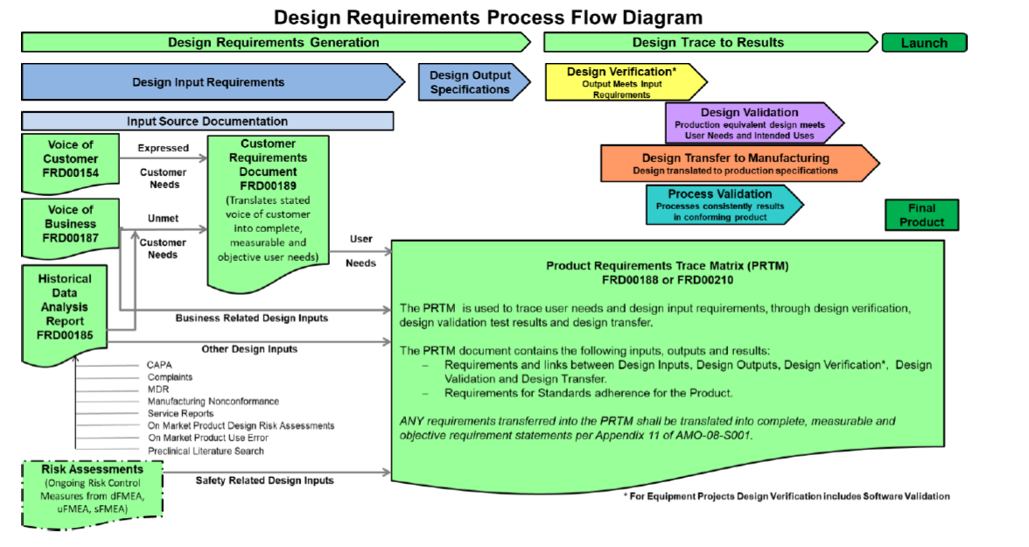
Surgical Vision deliverables mapped to Polarion Work Items
Verification Test Case
Design Output Specification
Verification Test Case
VOC
System Requirement
Design Transfer
VOB
User Need
HDA
System Requirement
Input Source
Key takeaway
The data model has a unique location for all Surgical Vision deliverables.

Slide 10
Surgical Vision deliverables mapped to Polarion Work Items
Voice of Customer
Is summarized by
Voice of Customer
Is derived by
User Need
Is validated by
Validation Test Case
Is derived by
Voice of Business
Is refined by
Is derived by
System Requirement
Is implemented / refined by
Historical Data Analysis
Subsystem Requirement
Not fully configured for JJSV
Is realized by
Risk Control
Is verified by
Is realized by
Design Output Specification
Verification Test Case
Key takeaway
The data model configured to match Surgical Vision processes and deliverables.

Slide 11
Server Architecture
JJSV Equipment and software only
Master JJSV- Equipment and software only
Project 1
Project 2
JJSV implantable
Master JJSV implantable
JJVC CEH
Project 1
JJVC Contact lens
Project 1
Project 2
Master JJVC CEH
Project 2
Master JJVC Contact lens
Project 1
Project 2
Maintained by VISION Project admin
Maintained by VISION Project admin
Maintained by Vision Project teams

Slide 12
Process definition

Slide 13
Verification protocol and report- Process
Protocol Creation
Protocol Approval
Report Creation
Report Approval
Defect tracking
New release
Protocol execution

Slide 14
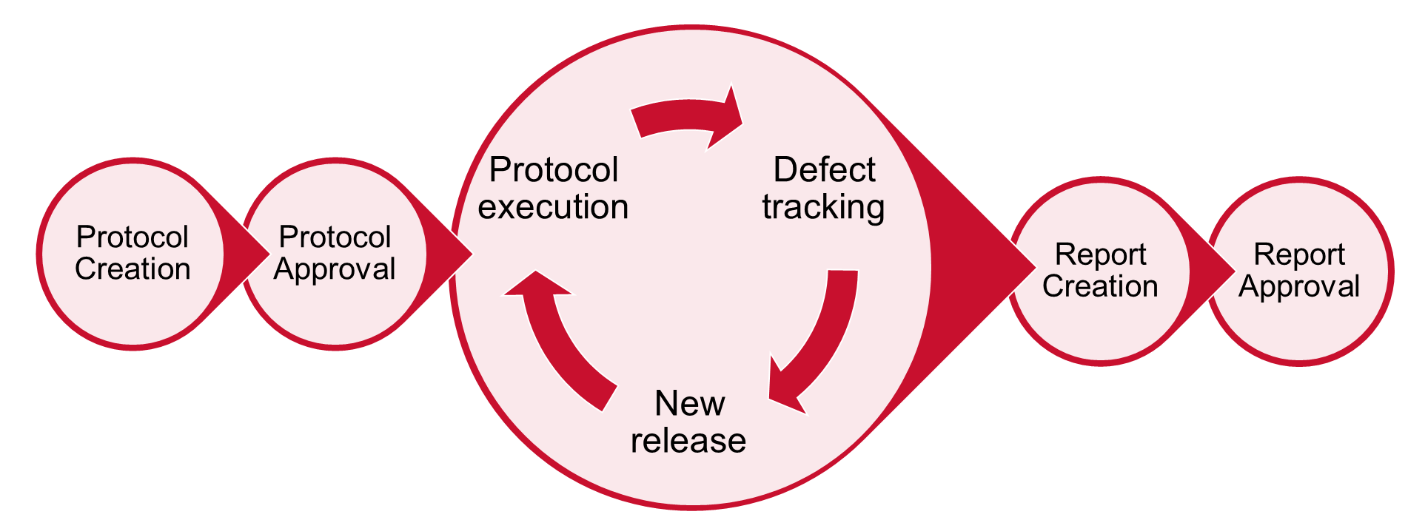
Verification protocol and report- Current process
Current Process
Created in MS Word saved in PDF and MS Word
Agile approval
New process
Created as Verification Test case WI, exported as PDF
Agile approval
Executed manually, results recorded manually in MS word
Executed manually, results recorded in Polarion test run
Create in MS Word, saved in PDF and MS word
Exported as PDF
Agile approval
Agile approval

Slide 15
Creation of Banner page
Create
Create document using pre-configured templates
Edit the document
Save
Save the document
Export
Export pdf and redline version
Edit
Demo- protocol
The templates in the Polarion system are maintained current by the Polarion Project team.

Slide 16
Verification protocol creation
SHOW the Protocol from Polarion
All three pieces.
Banner/cover page
Test run front page
Verification test case

Slide 17
Verification protocol approval

Slide 18
What happens when System Requirements changes???
Demo notifications

Slide 19
What happens when System Requirements changes to sub system requirement ??? What happens to linked Verification test case??
Demo notifications

Slide 20
Verification protocol execution

Slide 21
Verification defect tracking and new release
Not in scope for Polarion.

Slide 22
Verification report creation

Slide 23
Verification report approval

Slide 24
Validation
Notes:
This section should be left as is for now, TBD

Slide 25
Validation approach
IT validation
VISION specific customization validation
Total Validation package
Completed by Dave and Siemens Team.
Scope include but not limited to-
Server data back up
Disaster recovery processes/ requirements
Security management login testing/security breach etc.
Completed by Danny and TCS Team.
Scope include but not limited to-
Work items fields
Reports
Banner page set-up
QMS Procedures/Work instructions/training
User Acceptance Testing

Slide 26
Questions and follow-ups
Question/ Description | Status

Slide 27
Back-ups

Slide 28
Polarion vs DOORS- General

Slide 29
Polarion process- Tentative transition plan
Until Dec 2023
Polarion Project admin to create the Polarion project
2024 and beyond
Polarion Project admin to create the Polarion project
Project users create, edit and modify project data
NPD Project team identifies users for the Project.
TCS team upload legacy data
NPD Project team identifies atleast one project owner
NPD Project team identifies users for the Project.
NPD Project team identifies atleast one project owner
Project users upload legacy data
Project users create, edit and modify project data
Training provided by Polarion Project team
In-person training
Video conference
ComplainceWire
Training videos

Slide 30
QD2860B-PRO (alpine) VS LIB09172-PRO (elita)
QD there is no trace from req to individual test case. In LIB there is trace from req to individual test case.

